Slide 1
Clapper
Nameplate
Chime Tube
Tines
Slideable
Bumper

Slide 2
Care of the Chime
Removing chime from case by pick up from the opening of the chime tube.
Do not touch the clapper
Do not clang them together

Slide 3
The Grip
Position name plate between thumb and pointer finger
The thumb and pointer finger should be in a circle, completely surrounding the chime tube.
The remaining fingers grip naturally.

Slide 4
Ringing the Chime
Hold the chime upright, but tilt the chime back towards shoulder, so the clapper falls back.
Keep chime between waist and shoulder
Begin the ringing stroke by moving the arm down and out in an arc
At the end of the arc, flick wrist away from the body and in an elliptical motion return wrist to its former position. (the shape of the movement should be a football)

Slide 5
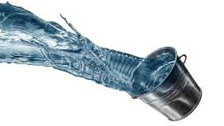
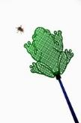
Ringing the Chime cont.
Keep the chime upright like it is full of water and you don’t want to spill it.
Pretend there is a fly on the wall smash and smear it up then bring chime back.

Slide 6
Dampen the Chime
Dampen chime by turning wrists inward and touch the chime to the front of the shoulder below the collarbone.
The chime may also be dampened on chest or stomach.

Slide 7
Twinkle Melody
CC GG AA G- FF EE DD C- GG FF EE D-
GG FF EE D- CC GG AA G- FF EE DD C-

Slide 8
Find your note

Slide 9
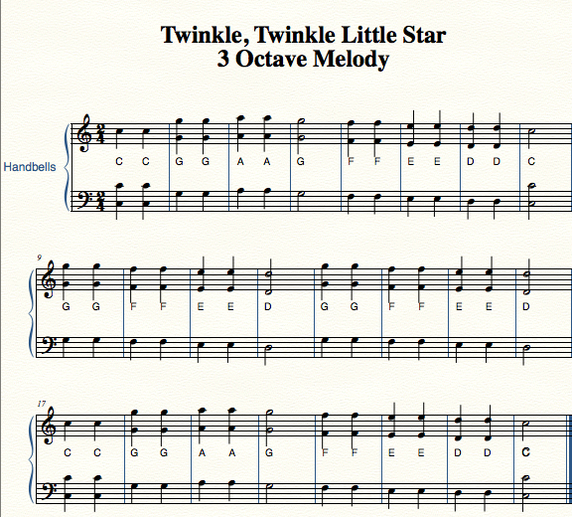

Slide 10
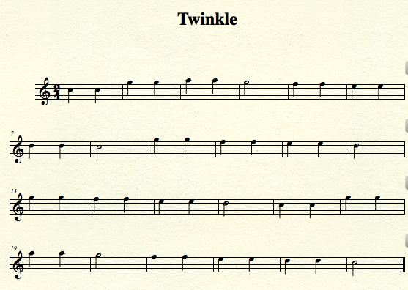
Twinkle 6th Octave

Slide 11
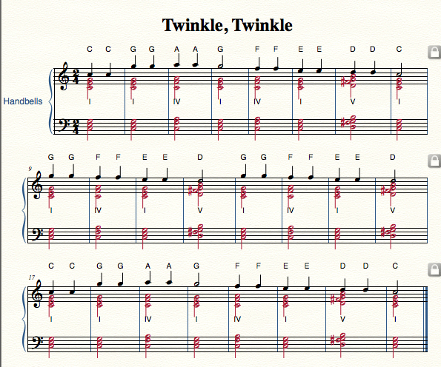
Fix C5
Red??

